Slide 1
Promoting Data Quality in PEDSnet Using GitHub
Aaron N. Browne, Jeffrey W. Pennington, L. Charles Bailey, MD, PhD
Notes:
happy to be here, presenting on…
did the work for this presentation under Jeff and Charlie, but much less than that done by the PEDSnet collaborators

Slide 2
Disclosures
Nothing to disclose.
Notes:
I have nothing to disclose.

Slide 3
Objectives
Describe PEDSnet EHR data collaboration
Highlight potential data quality issues
Introduce GitHub platform
Report on GitHub usage in PEDSnet
Data Quality improvement?
Future directions
Notes:
I’ll talk about…
What is PEDSnet? What data quality predicted? What is GitHub? How did we use GitHub, did it work? Future…
Jump right in.

Slide 4



Notes:
Familiarity check: heard of PEDSnet? working on PEDSnet?
PCORnet CDRN, all about children.
Baby so sad b/c aggregating data from 8 hospitals with ~70 (dancing?) collaborators.

Slide 5
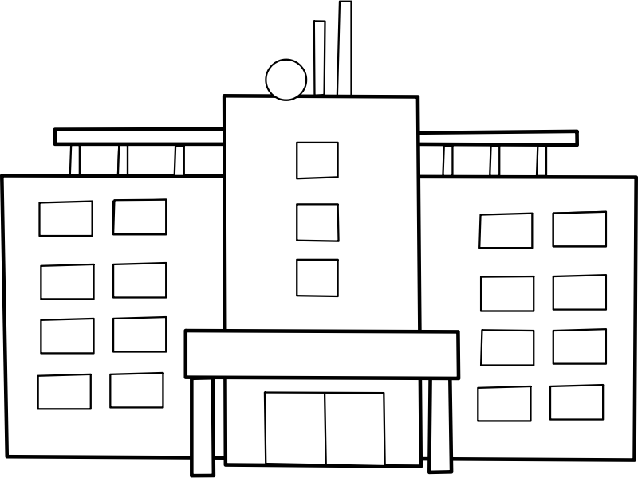
Notes:
Familiarity check: heard of PEDSnet? working on PEDSnet?
PCORnet CDRN, all about children.
Baby so sad b/c aggregating data from 8 hospitals with ~70 (dancing?) collaborators.

Slide 6

Notes:
Familiarity check: heard of PEDSnet? working on PEDSnet?
PCORnet CDRN, all about children.
Baby so sad b/c aggregating data from 8 hospitals with ~70 (dancing?) collaborators.

Slide 7
PEDSnet
2.1 million patients
2.8% of US children
22 state catchment area
Forrest, Christopher B., et al. “PEDSnet: a National Pediatric Learning Health System.“ Journal of the American Medical Informatics Association (2014): amiajnl-2014.
Notes:
Fantastic potential for research.
Currently aggregating and making data available.

Slide 8
Data Quality
EHR-inherent issues:
Accuracy
Objectivity
Believability
Extraction and transformation issues:
Completeness
Mis-representation
Kahn, Michael G., et al. “A pragmatic framework for single-site and multisite data quality assessment in electronic health record-based clinical research.” Medical care 50 (2012).
Notes:
Great potential; many potential problems.
EHRs are filled with inaccurate, non-standard, and just made up data.
ETL processes can suffer from incompleteness and general data model errors.
Hang on to this for a second!

Slide 9

Notes:
Familiarity check: Version control systems? Heard of git/GitHub? GitHub users?
Git was developed by Linus Torvalds, the “father of Linux”, to manage the Linux kernel. GitHub is a recent social web collaboration tool built around it.
PEDSnet uses GitHub to collaborate (private for now). Email and web notifications. “Feed view” and many other angles.

Slide 10

Notes:
Familiarity check: Version control systems? Heard of git/GitHub? GitHub users?
Git was developed by Linus Torvalds, the “father of Linux”, to manage the Linux kernel. GitHub is a recent social web collaboration tool built around it.
PEDSnet uses GitHub to collaborate (private for now). Email and web notifications. “Feed view” and many other angles.

Slide 11
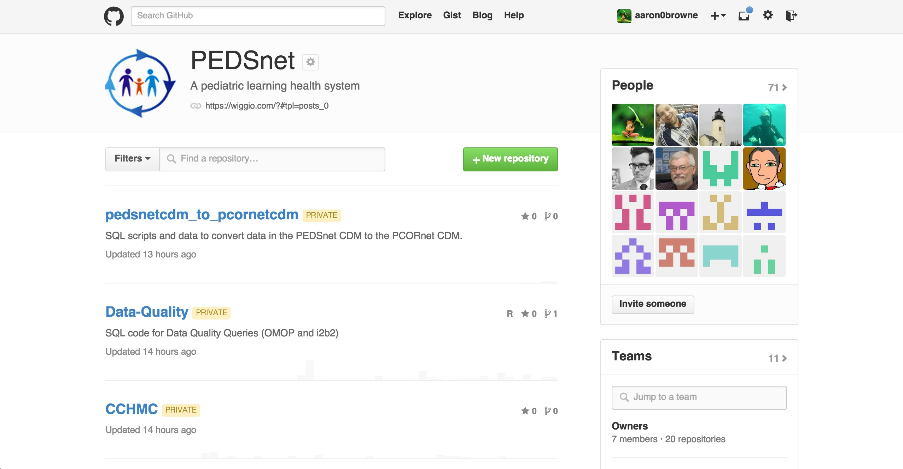
Notes:
Familiarity check: Version control systems? Heard of git/GitHub? GitHub users?
Git was developed by Linus Torvalds, the “father of Linux”, to manage the Linux kernel. GitHub is a recent social web collaboration tool built around it.
PEDSnet uses GitHub to collaborate (private for now). Email and web notifications. “Feed view” and many other angles.

Slide 12
PEDSnet on GitHub
71 members
11 teams
20 repositories
Workflow:
Issues
Comments
Commits
Pull Requests
Notes:
Teams for permission control.
Repos are focused code/doc packages: 8 for sites, others for query distribution and various operations and documentation.
Lines of code not measured b/c XML and false church of LOC.

Slide 13
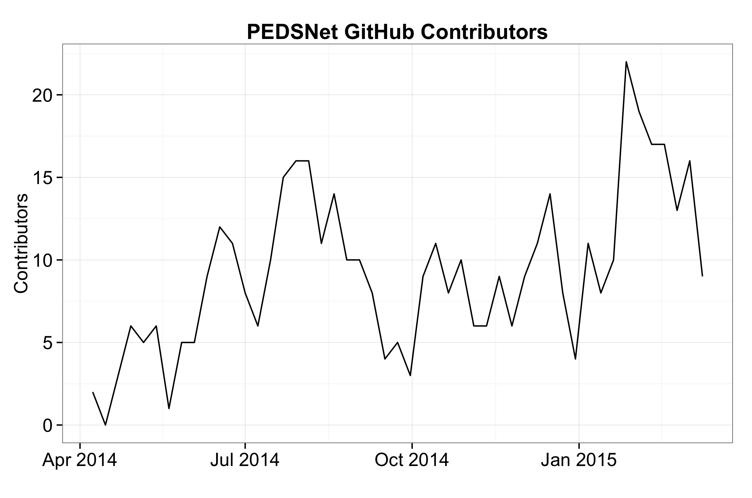
Contributors
Notes:
Opened an issue, authored a comment, closed an issue, authored a commit in that week.
Periodic peaks, general increase.
Represents all levels of management and developers. Michael Kahn and I.

Slide 14


Contributors
Notes:
Opened an issue, authored a comment, closed an issue, authored a commit in that week.
Periodic peaks, general increase.
Represents all levels of management and developers. Michael Kahn and I.

Slide 15
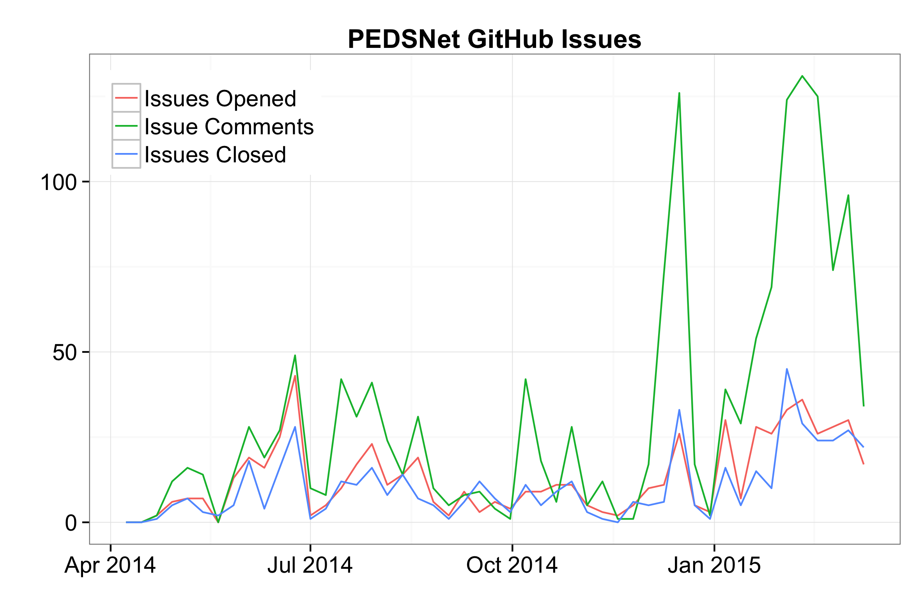
Issues
Notes:
Again, per week. High number of comments is great.
Some favorites and most commented…
Other issues tackled: case sensitivity, timezone support, data transfer feedback, data quality code dbms compatibility
Favorite comment: 721 words about stable person identifiers from Charlie Bailey, and it starts with…

Slide 16

Issues
Notes:
Again, per week. High number of comments is great.
Some favorites and most commented…
Other issues tackled: case sensitivity, timezone support, data transfer feedback, data quality code dbms compatibility
Favorite comment: 721 words about stable person identifiers from Charlie Bailey, and it starts with…

Slide 17
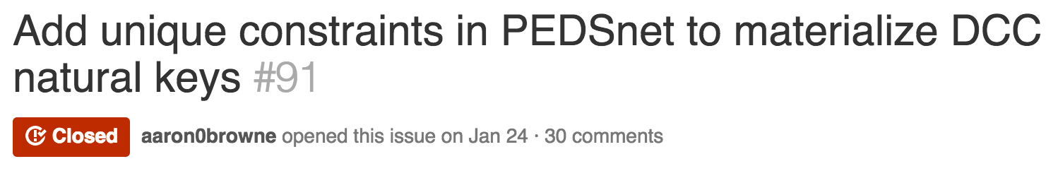
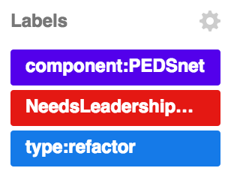
Issues
Notes:
Again, per week. High number of comments is great.
Some favorites and most commented…
Other issues tackled: case sensitivity, timezone support, data transfer feedback, data quality code dbms compatibility
Favorite comment: 721 words about stable person identifiers from Charlie Bailey, and it starts with…

Slide 18

Issues
Notes:
Again, per week. High number of comments is great.
Some favorites and most commented…
Other issues tackled: case sensitivity, timezone support, data transfer feedback, data quality code dbms compatibility
Favorite comment: 721 words about stable person identifiers from Charlie Bailey, and it starts with…

Slide 19

Issues
Notes:
Again, per week. High number of comments is great.
Some favorites and most commented…
Other issues tackled: case sensitivity, timezone support, data transfer feedback, data quality code dbms compatibility
Favorite comment: 721 words about stable person identifiers from Charlie Bailey, and it starts with…

Slide 20
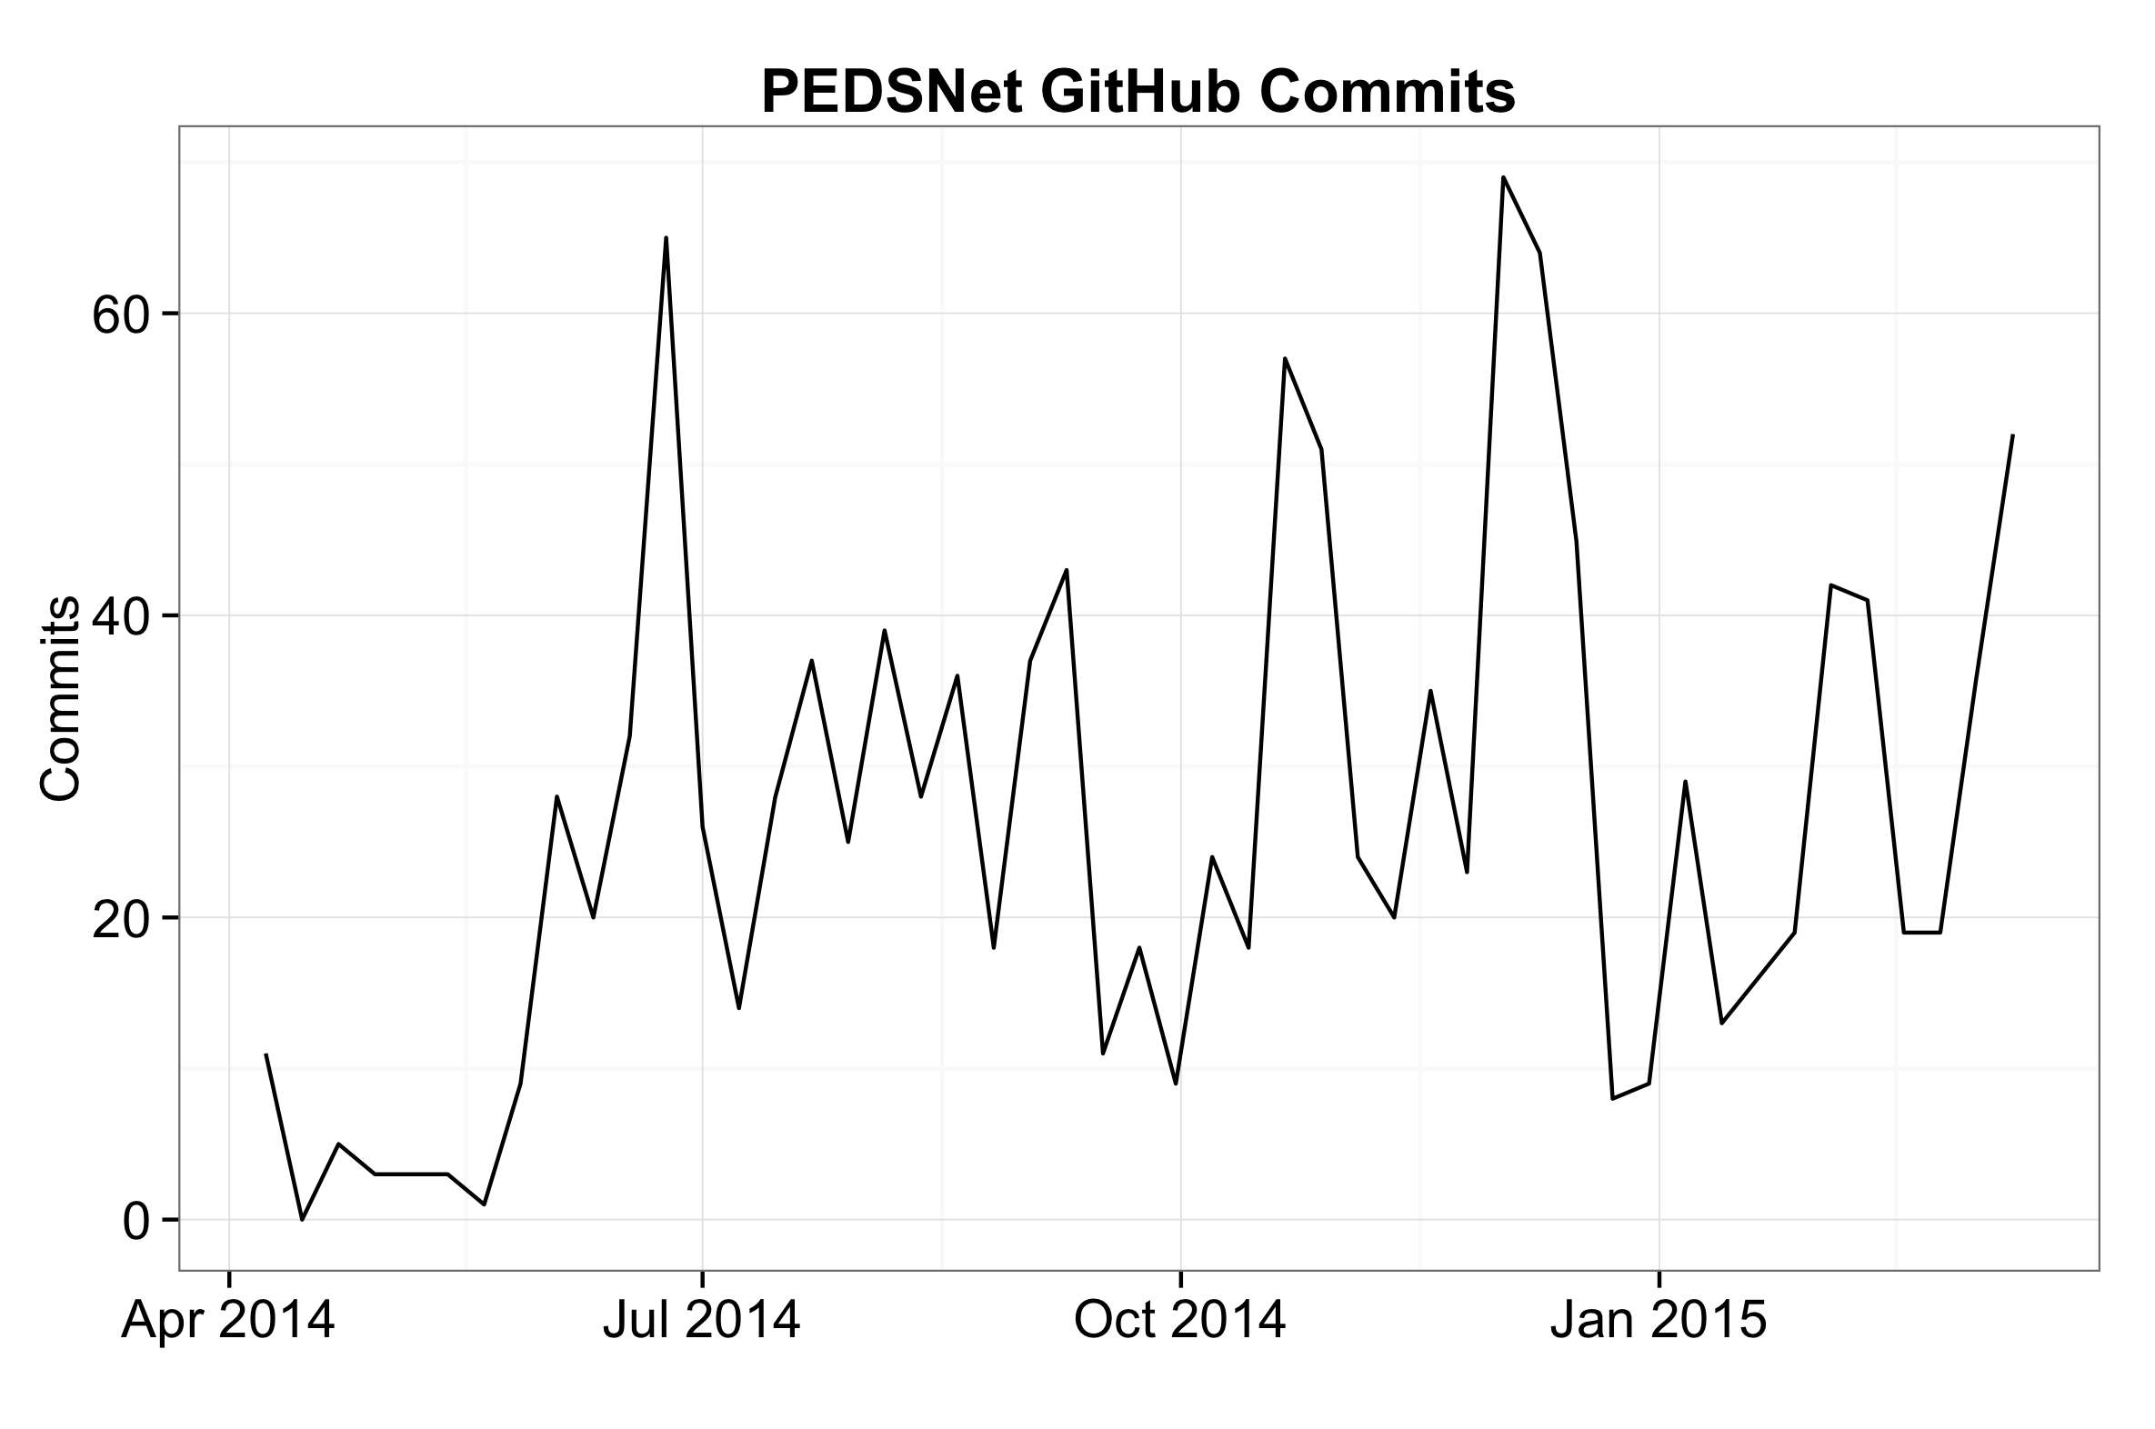
Commits
Notes:
Again, typical periodicity, but rising; good.
An example of commit list from internal PEDSnet CDM to PCORnet CDM transformation code.
An example commit change view.

Slide 21
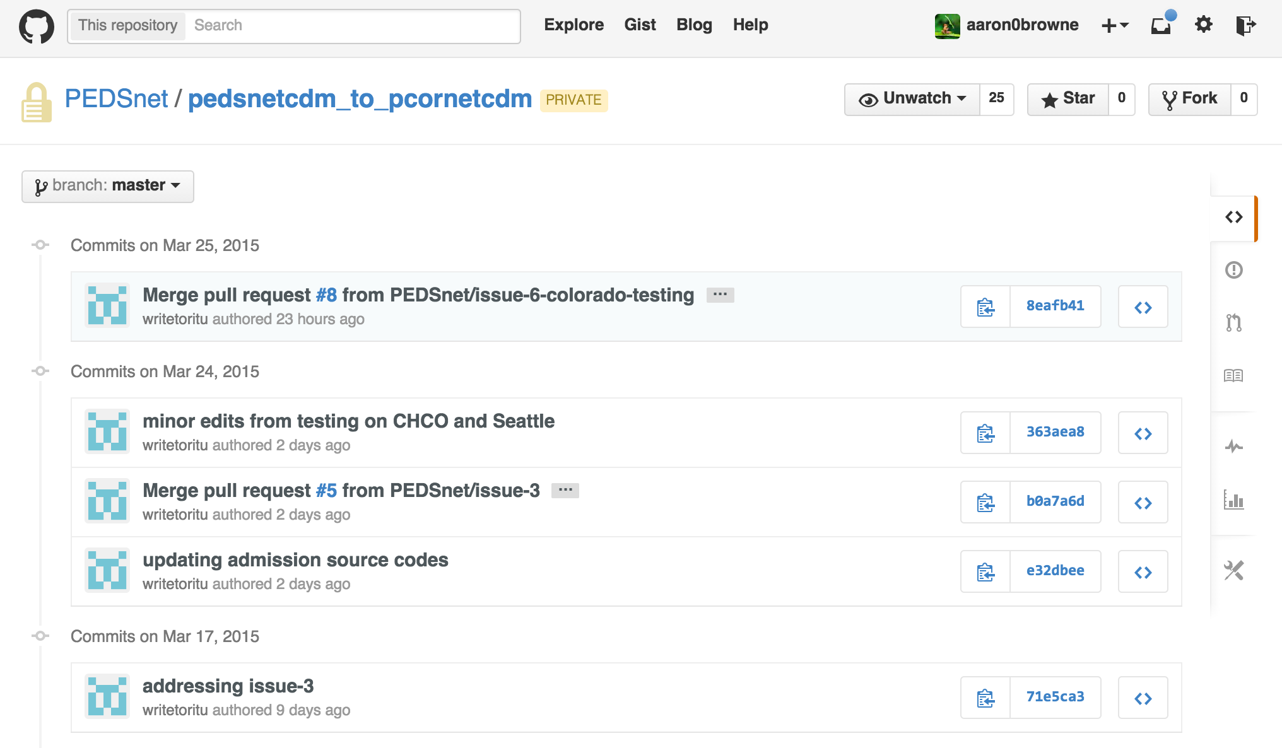
Commits
Notes:
Again, typical periodicity, but rising; good.
An example of commit list from internal PEDSnet CDM to PCORnet CDM transformation code.
An example commit change view.

Slide 22
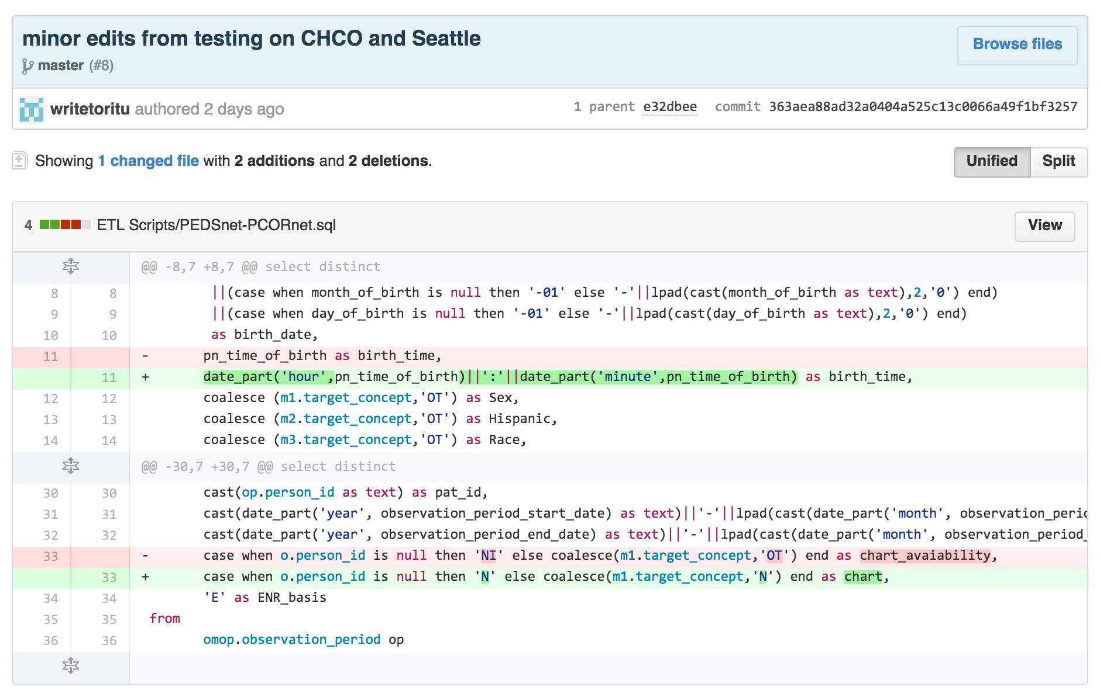
Commits
Notes:
Again, typical periodicity, but rising; good.
An example of commit list from internal PEDSnet CDM to PCORnet CDM transformation code.
An example commit change view.

Slide 23
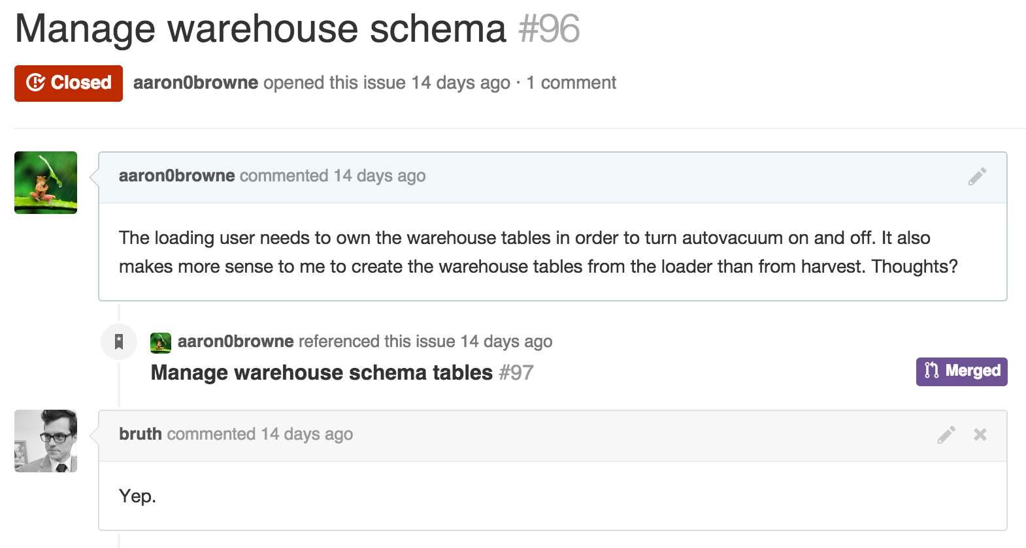
Workflow Example
Notes:
Didn’t report on PRs, b/c its more advanced, but here’s an example from an internal DCC repo.
Comment, PR, changes: documentation and code changes at the same time.

Slide 24
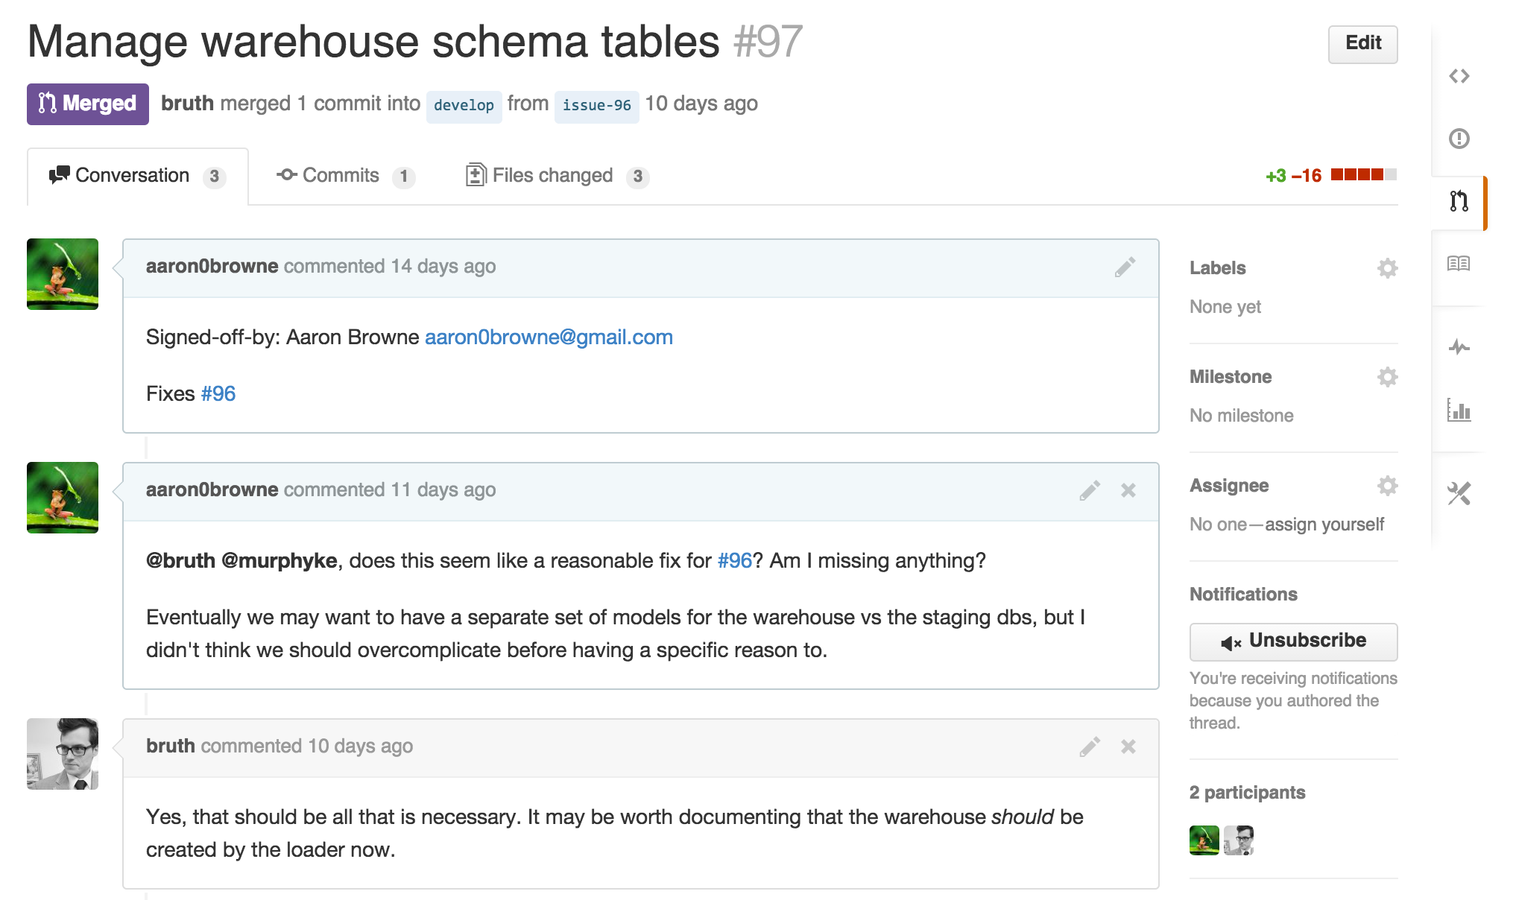
Workflow Example
Notes:
Didn’t report on PRs, b/c its more advanced, but here’s an example from an internal DCC repo.
Comment, PR, changes: documentation and code changes at the same time.

Slide 25
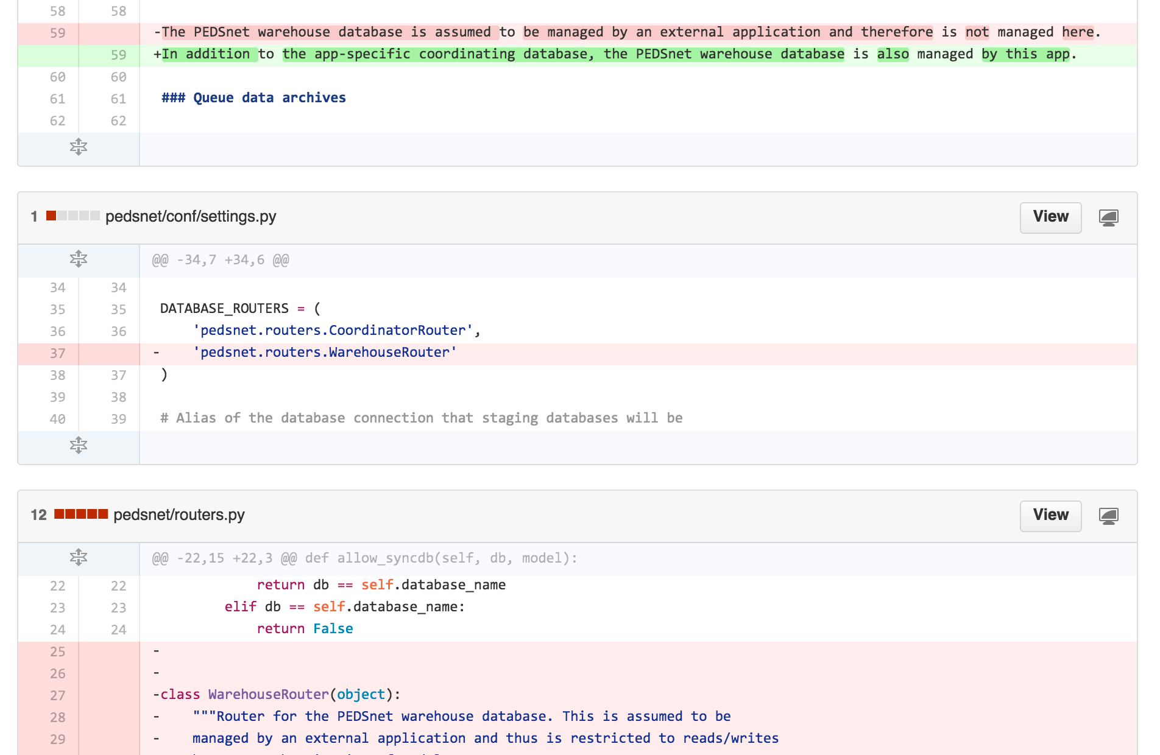
Workflow Example
Notes:
Didn’t report on PRs, b/c its more advanced, but here’s an example from an internal DCC repo.
Comment, PR, changes: documentation and code changes at the same time.

Slide 26
Conclusions
Data quality results:
Early distribution and debugging of DQ tools
Early and often code reviews
Convention discussion and distribution
Transparency!
Future work:
Re-use GitHub data for end-user trust

Slide 27
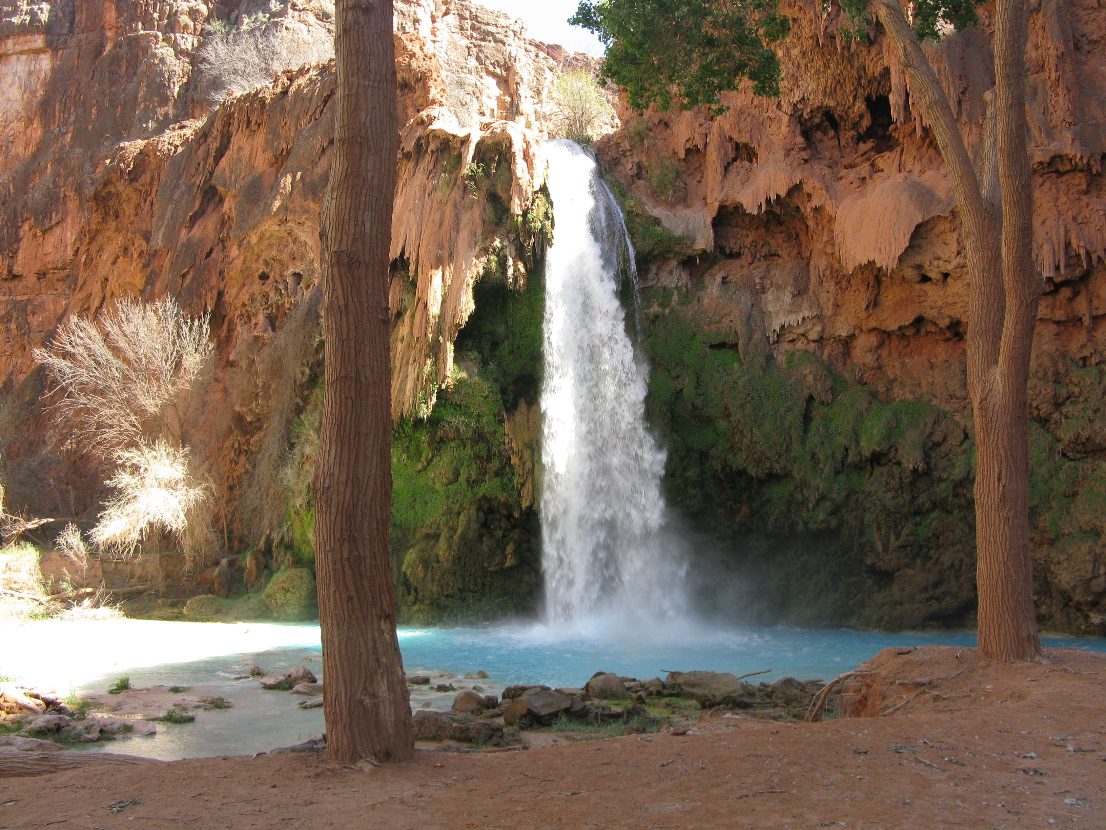
Questions?
supported by PCORI Contract CDRN-1306-01556

